Slide 1
Steward Training March 2023
Local 459

Slide 2
Introduce Yourself in the Chat
In the chat box, please put:
1. Your name
2. Your workplace
3. Are you currently a steward? Or are you here to learn more?

Slide 3
Agenda
State of the Union Address by President Sharon Taylor
Group Discussion: Why do people choose to be stewards?
The Equality Rule (Lance Rhines)
Weingarten Rights (Kerry Miller, Kristen Silvers)
The Organizing Model (presentation & breakout groups)

Slide 4
Group Discussion: Why Do People Choose to be Stewards?

Slide 5
Question for those who are already a steward . . .
Did you have any fears or reservations about becoming a steward? If so, what made you decide to do it anyway?

Slide 6
The Equality Rule
Union stewards are equal to management when they are acting in their representational capacity
“Representational capacity” = when a union steward argues a contract matter, attempts to resolve a problem, investigates a complaint, request information, presents a grievance, disputes a decision affecting the bargaining unit, or leads a union protest.

Slide 7
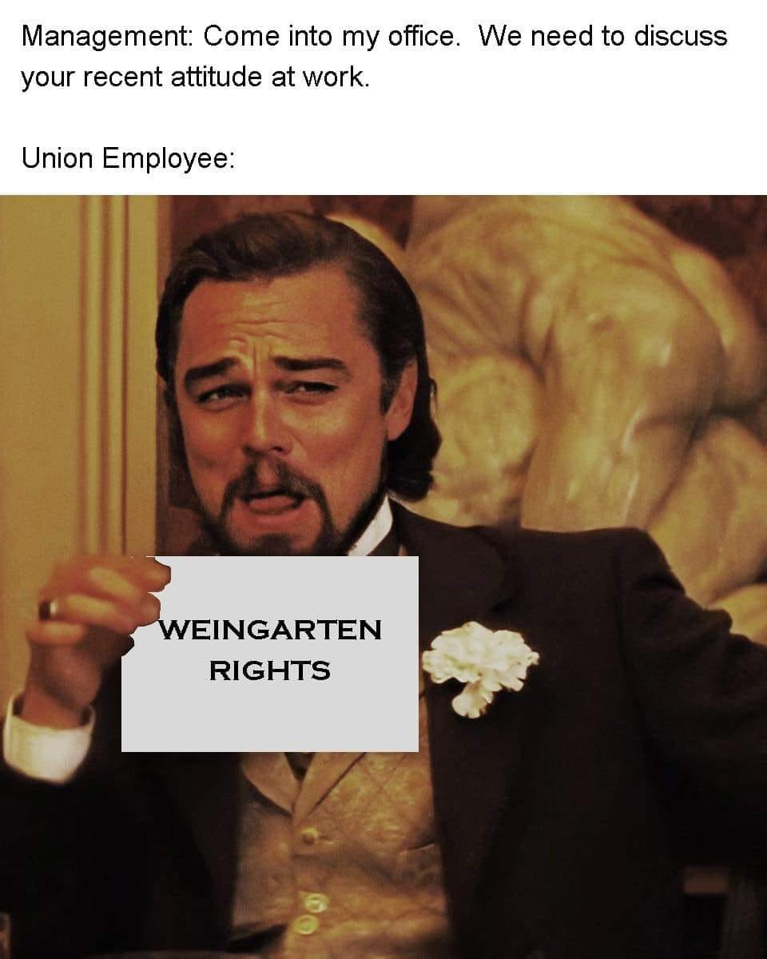
Weingarten Rights
An employee has the right to have a shop steward present when the employee “reasonably believes” s/he is going through – or is about to go through – an investigatory interview. These are called Weingarten Rights. The results of the investigatory interview may be used to issue discipline against the employee. The employee must request that his/her shop steward be present.

Slide 8
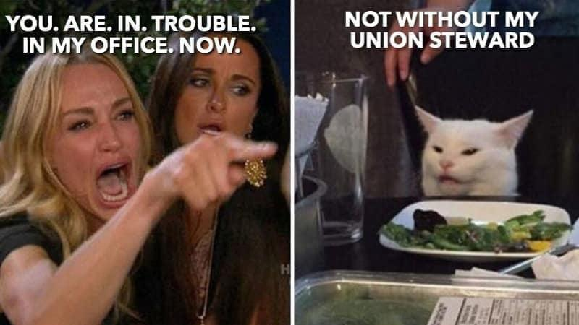
Weingarten Rights
When a steward is called to the investigatory meeting, they . . .
must be allowed to take the employee aside for a pre-interview conference.
has the right to speak during the interview; however, does not have the right to bargain over the purpose of the meeting.
may ask for clarification of a question.
may counsel the employee on how to answer a question.
may provide supplementary information to the supervisor.
may call for a caucus to speak with the employee in private, outside of the room.

Slide 9
Weingarten Rights
For an overview, see this OPEIU link

Slide 10
What is the “organizing model”?

Slide 11
Service Model
Organizing Model
Members’ problems are solved by others (e.g., chief steward or service rep)
Members see “the union” as an outside organization
Grievances are settled with little input or involvement from members
Top-down relationship - Members feel disconnected from vision and strategy
The union is “transactional” – a business the provides a service
Members are taught and empowered to solve their problems, especially through collective action
Members see themselves and their coworkers as the union
Members are encouraged to participate in grievances in concrete ways
Grassroots solidarity - Members feel their voices and actions play an important part in their union
The union is “transformational” – together we are changing our workplace and world for the better

Slide 12
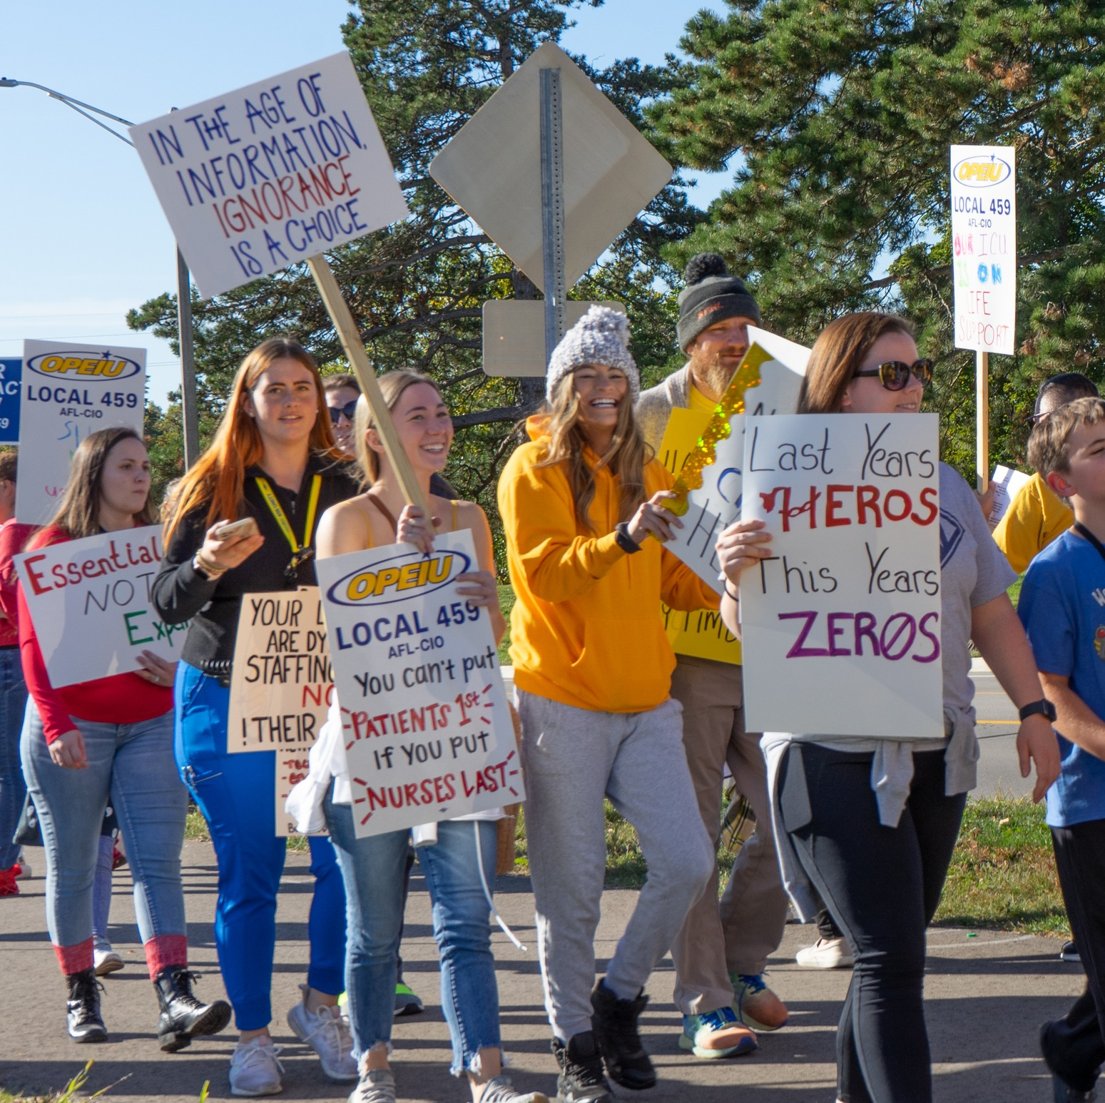
Organizing Around Issues
Not every issue is good for organizing, but we need to capitalize on the ones that are.
3 key questions need to be asked before developing a plan:
Is the issue widely felt?
Is the issue deeply felt?
Is the issue winnable?

Slide 13
Breakout Groups
Everyone will be assigned to a random group
In your group:
Choose one person’s workplace to focus on
Develop a plan to strengthen the foundations of the union and empower members
What will the first steps be? The next steps? How will you know if the plan is working?
Choose one person to report back your group’s plan

