Slide 1
Stewards: Workplace Leaders
Steward Training
November 2022

Slide 2
Agenda
Introductions
What is a Steward?
Roles of a Steward
Distinguishing a Grievance from a Gripe
Employee Handbook vs. Collective Bargaining Agreement (CBA)
Knowing Your CBA
The First Step in Every Grievance Process
The Next Steps of the Grievance Process
Grievance Scenarios
The Importance of Notes

Slide 3
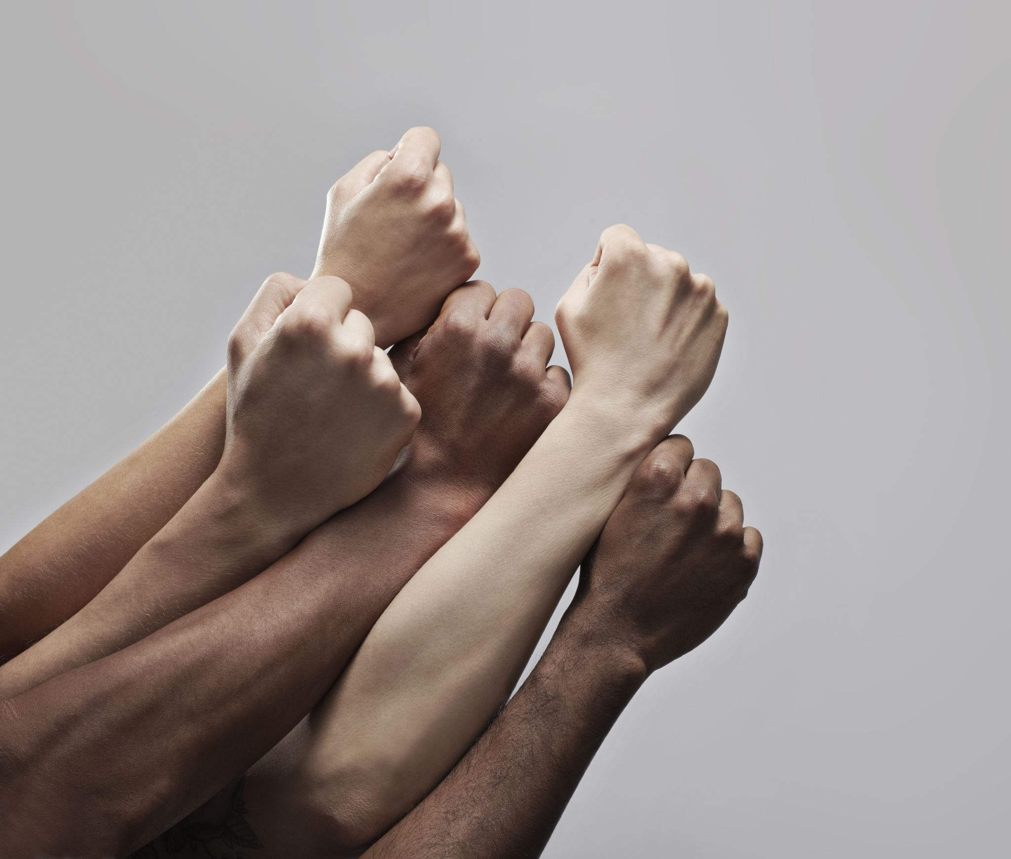
Introductions
Name
Employer
How long have you been there?
How long have you been a Steward or Alternate?

Slide 4
What is a Steward?
A steward is a union representative in the workplace.
Elected by members in the area/unit
Note: a steward may be appointed by the union Executive Board if the position is vacant and no other member seeks the position
The “eyes and ears” of the workplace

Slide 5
Union Steward
Local 459
Chief Steward and Service Representative
GENERAL JOB DESCRIPTION
Union leader in the workplace/department, representing bargaining unit members.
DUTIES AND RESPONSIBILITIES:
Must be able to read and understand the contract
Attend investigation meetings with members and supervisor/mgmt
Must have ability to understand the grievance process
Knowledge and ability to write a grievance
Attend at least two steward trainings per year
Keep your Chief Steward and Service Representative informed of your investigations
Encourage members to participate in union activities
Keep a positive attitude regarding the union
Sign up non-members
Assist with union votes
Help with New Hire Orientation
Develop a relationship with mgmt (without compromising any member rights)
No direct dealing with mgmt
Participate in community events if possible
Able to communicate with members in a positive manner

Slide 6
Roles of a Steward
Advising
Advocating
Communicating
Educating
Empowering
Handling grievances
Organizing
Promoting social justice
*No matter what role you’re fulfilling, you must never forget the Duty of Fair Representation

Slide 7
Advising members . . .
Be an active listener.
A coworker may need to know their conduct could get them into trouble that no grievance can save them from.
An employee may need to consider taking leave from work, if their health or personal life requires.
A member may or may not listen to the steward’s advice, but it’s important to feel comfortable providing such work-related counsel when appropriate.

Slide 8
Advocating for members . . .
A union balances the power between employers and employees. A steward is a visible sign of that balance of power.
Stewards are equals with management when serving in their union role.
Advocacy can take many forms.
In any case, the steward speaks on behalf of their coworkers, remaining vigilant against management attempts to violate the contract or suppress the voice of union members.

Slide 9
Communicating with members . . .
Stewards are the faces of the union to most members.
A steward connects members with each other.
A union is based on a network of workplace relationships, connecting union members in a strong support system, based on their identity as an organized collective.

Slide 10
Educating members . . .
As a steward, you know there’s a contract that limits management’s rights.
You also know the law protects employees who exercise their rights.
Part of the steward’s job is getting coworkers to understand these protections (as well as Weingarten Rights and Right-to-Work)
Knowledge is power.
This Photo by Unknown Author is licensed under CC BY-SA

Slide 11
Empowering members . . .
A union can’t be a few people always solving problems for everyone else.
The goal is to get union members to realize their own power.
A steward helps members get comfortable asserting the contract and standing against unfairness in the workplace.
A steward helps members understand and feel that they are the union.
This Photo by Unknown Author is licensed under CC BY-SA-NC

Slide 12
Handling grievances . . .
A steward needs to know the basics of how the grievance process works.
A grievance is how we enforce our contract.
A steward should be the first union contact in every grievance, helping filter out grievances from gripes.

Slide 13
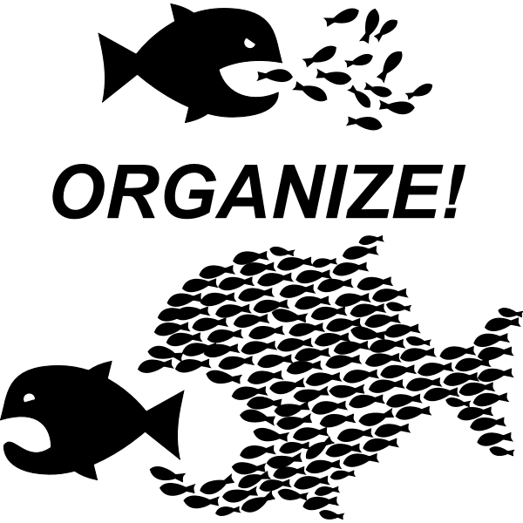
Organizing members . . .
If there’s an opportunity to get workers talking together, strategizing together, and acting together, a steward tries to make it happen.
Members learn what a union is by taking part in collective action.
Organizing includes getting new members signed up.

Slide 14
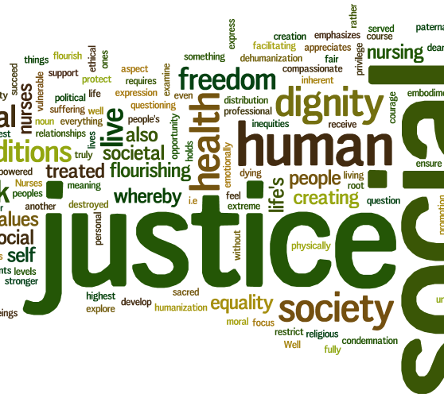
Promoting social justice . . .
Throughout American history, unions have been at the forefront in advancing civil rights and social welfare programs.
Our members are negatively impacted, as workers and as human beings in general, by the broad problems of racism, sexism, and classism.
A steward should not shy away from addressing these issues when possible.
This Photo by Unknown Author is licensed under CC BY-SA-NC

Slide 15
Duty of Fair Representation (DFR)
DFR Defined
Best Practices
The requirement that a union/steward represent all bargaining unit members fairly.
Violated if the union/steward acts in a way that is:
Arbitrary (without effort or rationale)
Discriminatory (based on race, sex, religion) (also, dues-paying status)
In bad faith (intent to do harm)
Investigate thoroughly, even if you don’t think it’s a grievance
Keep a record of what you do
Be able to explain what you do (or don’t do)
Keep the employee informed of your rationale
A steward is not expected to be perfect or to always be right! The key is to work in good faith for represented employees’ best interests.

Slide 16
Is it a Grievance or a Gripe?
GRIEVANCE
Is enforceable through use of the contract, it addresses specific violations of contract language or contract practices. A grievance is a formal challenge to the employer that the contract has been violated.
Examples:
Supervisor refused to pay time and a half for overtime worked.
Supervisor allowed a lower senior to pick up extra hours over a higher senior.
GRIPE
Is not generally enforceable, they are complaints that are not actually contract disputes. A complaint about an incident or condition that does not violate the contract.
Examples:
Insulting remarks or name calling.
Employee (co-worker) not working fast enough.
The co-worker smiles too much.

Slide 17
Is it a Grievance or a Gripe?
Fortunately, most problems can be settled informally without filing paperwork. But it is imperative that you contact your Union steward or Representative as soon as possible when you feel you have a grievance, they will inform you if it’s a grievance or a gripe. There are strict timeless for the filing process.

Slide 18
Employee Handbook vs. Collective Bargaining Agreement

Slide 19
Know Your CBA

Slide 20
The First Step of Every Grievance
Whenever there is a dispute over the contract, the first step is always an informal discussion with the supervisor.
Clearly state what has happened
State what part of contract, past practice, or policy has been violated
State what remedy the employee is seeking
Request information if needed (check with Chief Steward or Service Rep about formal info request)
Remember: any resolution must be in compliance with the contract.

Slide 21
The Rest of the Grievance Process
Formal (Written) Grievance
Steward/Chief Steward/Service Rep submits written grievance
Meeting to argue case, present evidence, answer questions
Employer responds by denying, granting, or offering settlement
If unresolved, continue to next step . . .
Note: the number of steps may vary in each contract

Slide 22
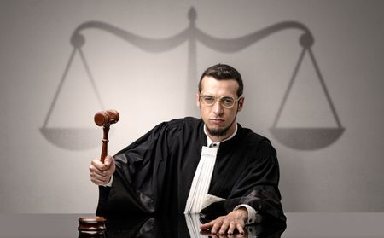
The Rest of the Grievance Process
Arbitration
An arbitrator is a neutral third party that hears the grievance and renders a final and binding decision
The Service Rep submits notice of intent to the employer
The Union (or Employer) may request a pre-arbitration meeting, which is another attempt to resolve the grievance
If still not resolved, the grievant, Chief Steward, and Service Rep present to union Board to advance to arbitration
The arbitrator’s decision is final and binding

Slide 23
Know Your Timelines!
Timelines are found in the Grievance Procedure and Arbitration article of contract
May be different timelines for each step
Make sure you don’t miss deadline!

Slide 24
Know Your Timelines!
“Working Days” vs. “Calendar Days
Working days do not count Saturdays, Sundays, and holidays
Check contract for definition
Calendar day includes all 7 days of week, even holidays
Tip
Don’t wait until last day! File as soon as you can. Unexpected things come up: illness, workload, family emergencies, etc.

Slide 25
Scenario 1
Sarah, a Mental Health Therapist, is upset because her Supervisor has been giving negative performance evaluations for arbitrary reasons. The Supervisor commented she “doesn’t have a professional demeanor at staff meetings . . . needs to get better at dealing with workplace disagreements with a solution-based mindset instead of an argumentative mindset . . . and needs to be mindful of the impact of her words before speaking.” When Sarah pressed the Supervisor for examples, the responses were vague.
Sarah does not pay union dues. She approaches you, exasperated, demanding to file a grievance and asking, “what good is the contract if we can’t stop a Supervisor from doing this kind of thing?”
You know that the Supervisor can be difficult and unfair. You’ve heard many examples in the past.
What do you do?
Clinton, Eaton, Ingham Cty Community Mental Health Association (CEI-CMHA) Large Unit Contract

Slide 26
Scenario 2
Eddie, an RN, approaches you because he was given a Step 1 corrective action for being on his phone, on September 25th, showing coworkers a comedy video with profane language, at the nurse’s station. On October 10th, his supervisor asked if she could talk with him in her office about staffing concerns he had expressed. While in the office she said, “but you have time to be on your phone, right? I heard you and Gerald were watching a video at the nurse’s station a few weeks ago. Is that true?” Eddie acknowledged it was true but explained it was only for a minute and he technically hadn’t ended his break yet. Three days later, on October 13th, the supervisor issued a corrective action. Eddie doesn’t feel this is fair because he didn’t have a steward at the meeting. He wants to file a grievance.
What do you do?
McLaren Greater Lansing RN Contract

Slide 27
The Importance of Notes
The Essentials
Date, time, name of employer, purpose of meeting at top of page
Full names of everyone in attendance, and their title, on first page
Number the pages (1 of 4, 2 of 4, etc.)
The 5 W’s: Who? What? When? Where? Why?
Tip: Ask for and note the date mgmt. became aware of the issue

Slide 28
The Importance of Notes
You won’t be able to recall everything
Write direct quotes of what each person said. If you don’t catch something, ask the person to repeat
When in doubt, write it down. It may be useful later
After meeting, review for accuracy and give to Chief Steward or Service Rep
Written records may be used in grievance meeting or arbitration
Helps compare accounts of same incident/issue
May serve as evidence that you fulfilled Duty of Fair Representation

